Slide 1
Sales Forecasting
Machine Learning
---- Time Series Approach
Pooja Sureja
02 April, 2022

Slide 2
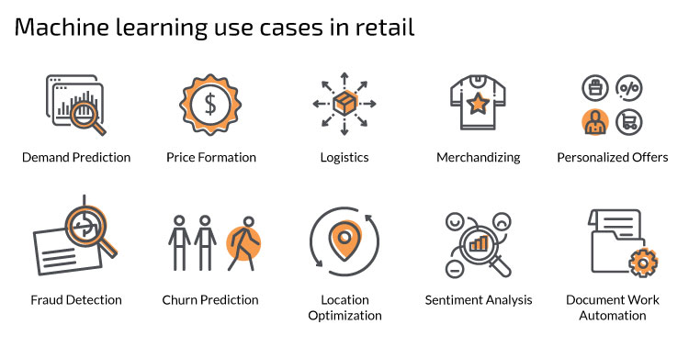
Machine learning in the Retail sector

Slide 3
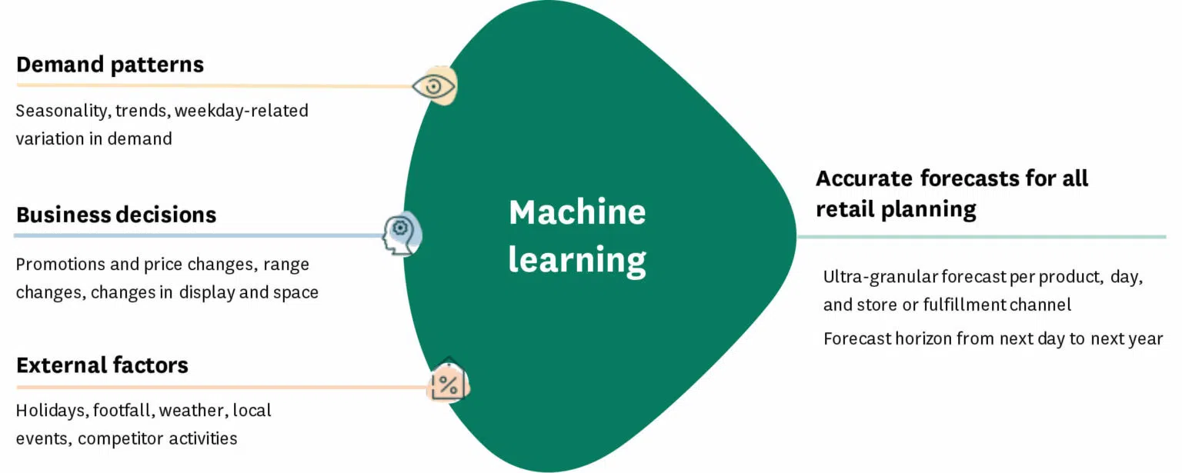
Retail Sales Forecasting

Slide 4
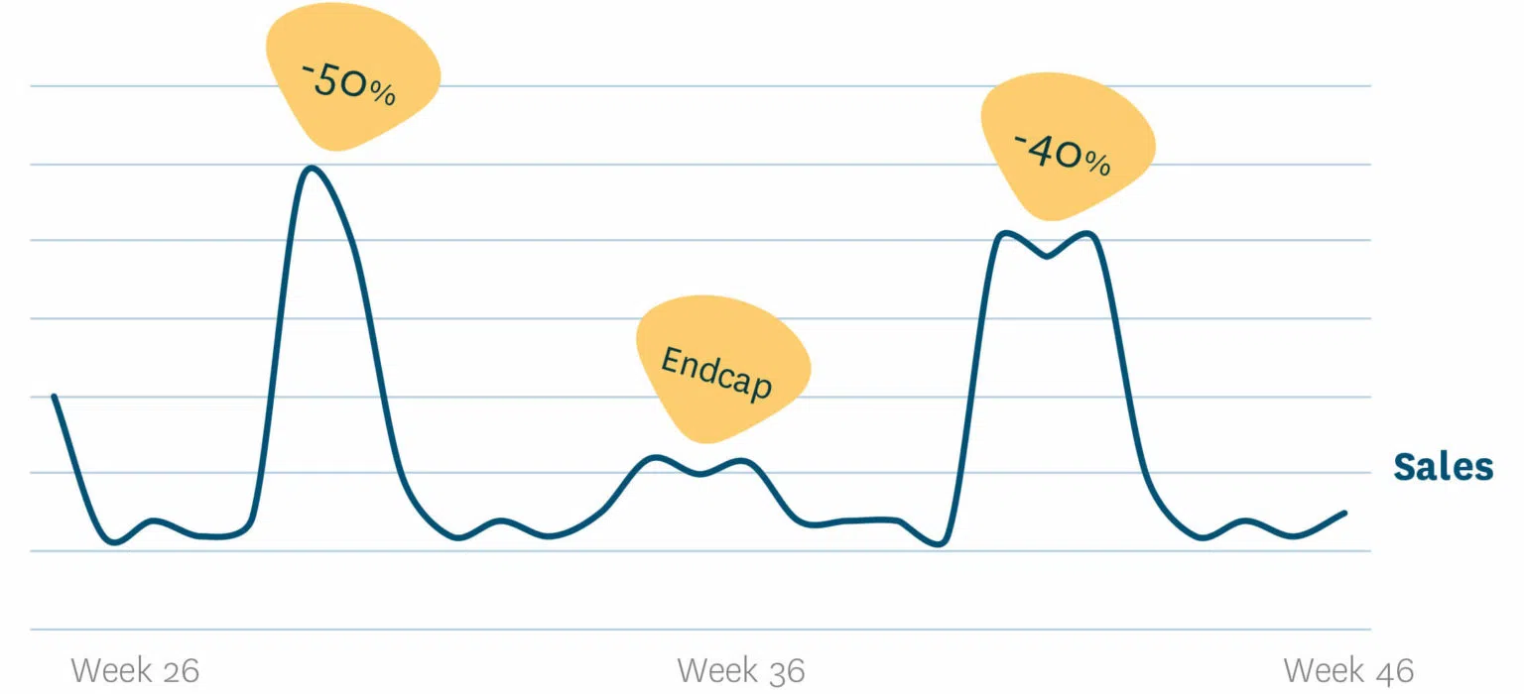
Objective/Problem Statement:
Predict the sales for the following year
Analysis of the effects of markdowns on holiday weeks
Provide recommended actions based on the insights drawn, with prioritization placed on the largest business impact

Slide 5
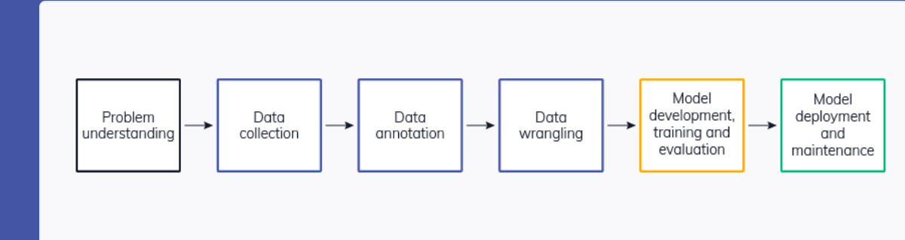
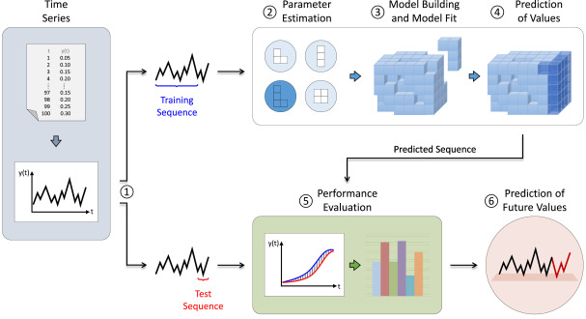
My Approach towards the project
Time Series
MS Word
Python(Pandas/NumPy)

Slide 6
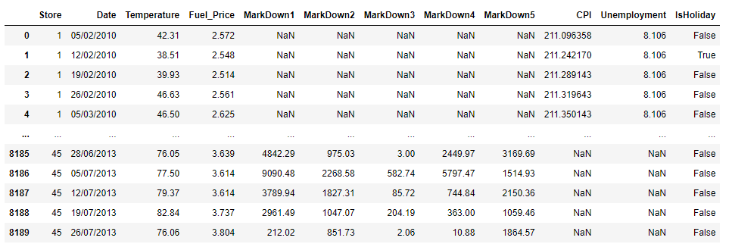
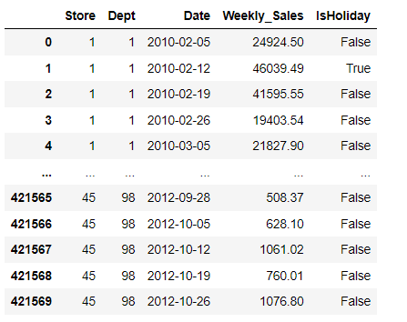
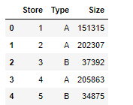
Data Collection
Number of records used for modeling: 421569 datapoints

Slide 7
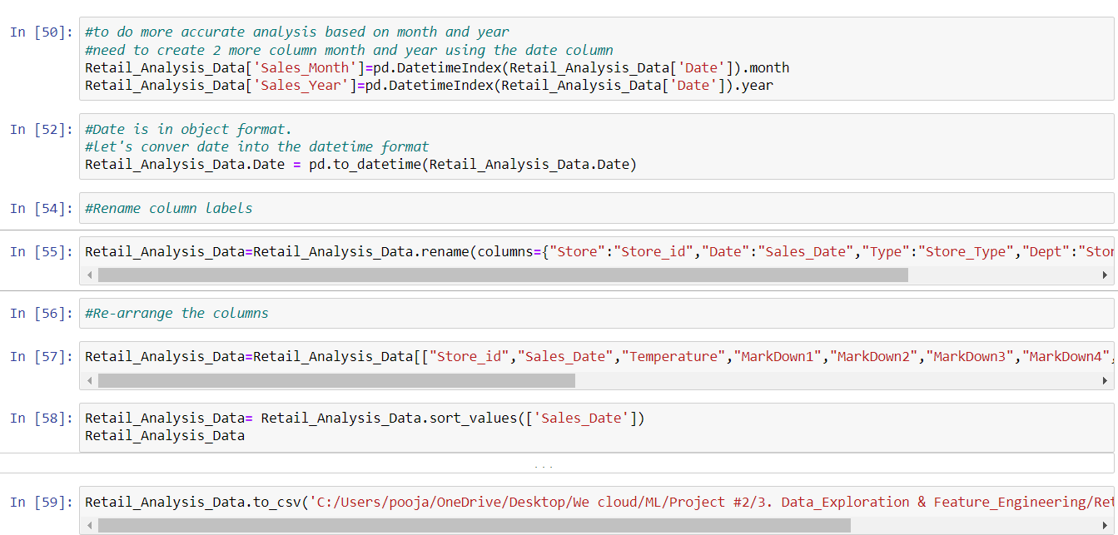
Feature Engineering
The dataset had many empty and irrelevant features They have been removed.
● Date values have been formatted to Datetime
● Redundant variables have been dropped.
● Filled NAN values with mean values of corresponding columns.
● Removed duplication of records if any.

Slide 8
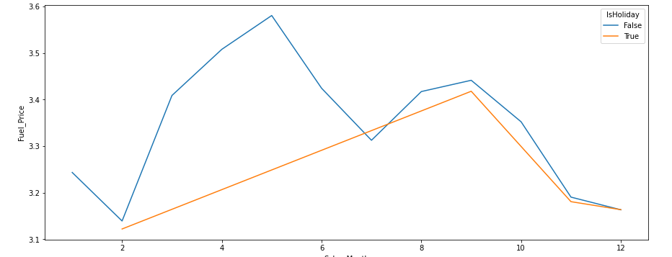
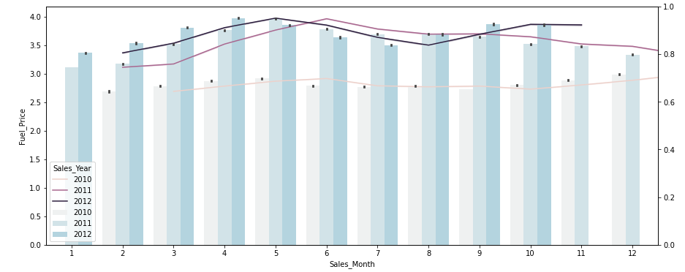
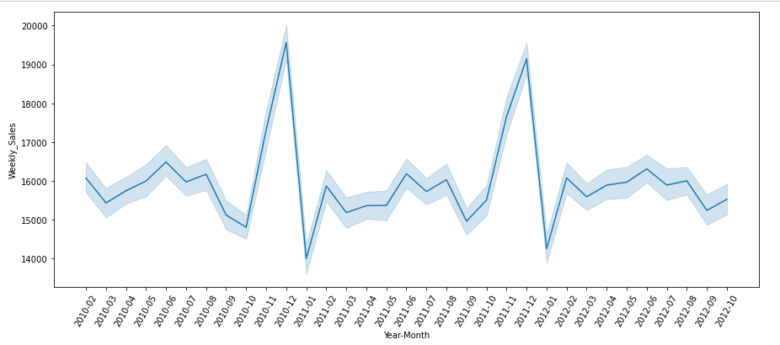
Data Analysis

Slide 9
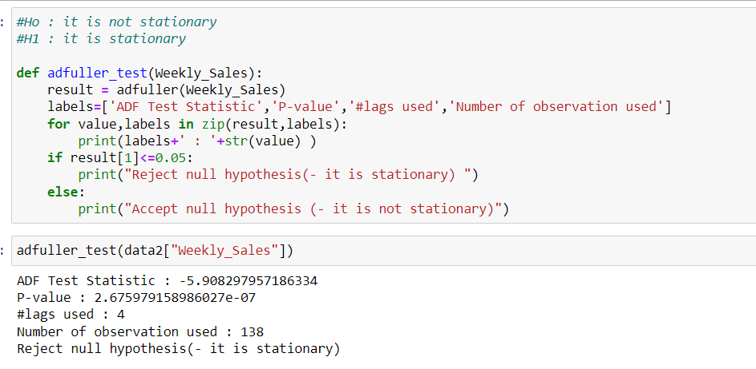
Data Preprocessing
Performed Simple Moving Average for mean and standard deviation
Trend of the data
Check data For stationary
Rolling Method
Dickey–Fuller test

Slide 10
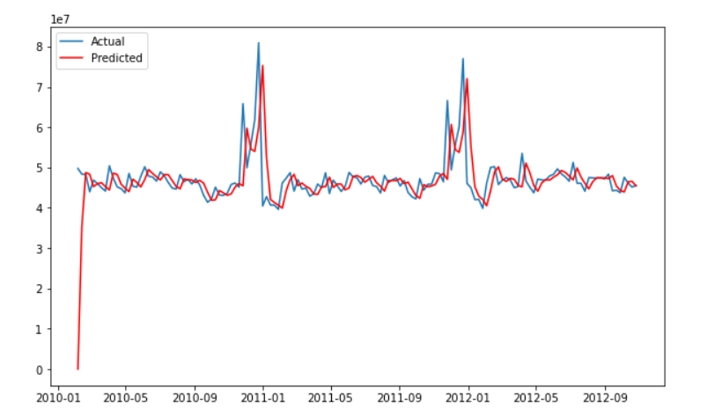
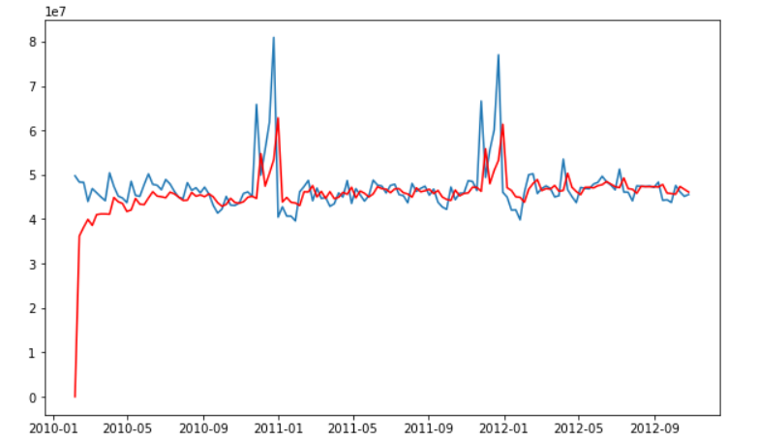
Machine Learning Model Applied
ARIMA
SARIMAX

Slide 11
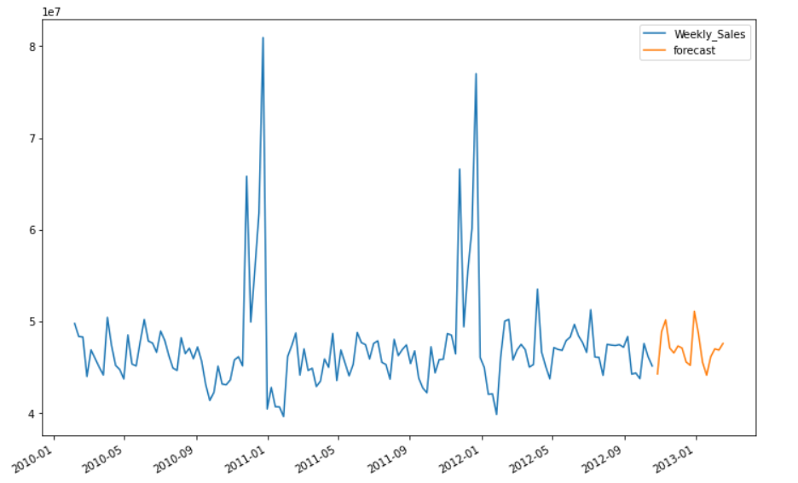
Model Forecast/Result
Work In process:
I am still working on validating the forecast model (to make sure it performs well)

Slide 12
Future Scope:
Future Scope
I have already used the Arima and Sarimax model to check the prediction of the data, However, the performance is still not as good as it could be.
In order to solve this problem, we can try another modeling called fbprophet and also perform hyperparameter tuning on Arima and Sarimax model
Thank You

